Slide 1
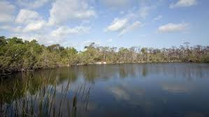
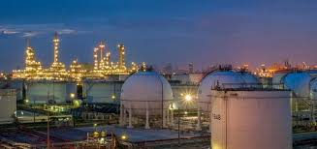
Resource and Development

Slide 2
What is Resource?
Anything present in our environment which can be used to satisfy our needs, provided it is technologically accessible economically feasible and culturally acceptable is called a RESOURCE.

Slide 3
PHYSICAL ENVIRONMENT
(NATURE)
HUMAN BEINGS
TECHNOLOGY
INSTITUTIONS

Slide 4
RESOURCE
RENEWABLE
NONRENEWABLE

Slide 5
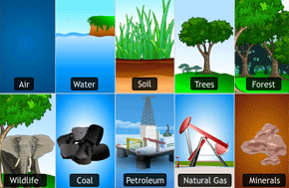
SOME EXAMPLES
RENEWABLE
NON RENEWABLE

